Slide 1
Mobile Application Development
David Drohan (ddrohan@wit.ie)

Slide 2
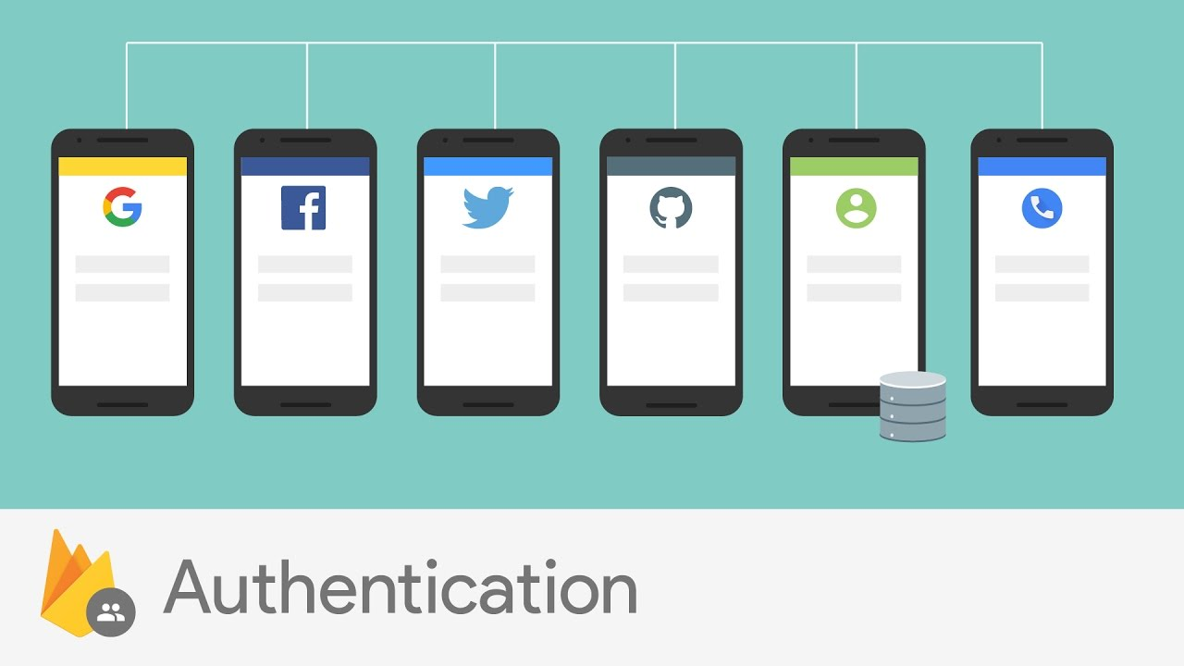

Firebase Authentication
All goodness bundled as one…

Slide 3
Overview (Recap)
Most apps need to know the identity of a user. Knowing a user's identity allows an app to securely save user data in the cloud and provide the same personalized experience across all of the user's devices
Firebase Authentication provides backend services, easy-to-use SDKs, and ready-made UI libraries to authenticate users to your app. It supports authentication using passwords, phone numbers and popular federated identity providers
You can let your users authenticate with Firebase using their Google Accounts by integrating Google Sign-In into your app.

Slide 4
Overview
With the Google Identity Platform for Android, you can allow application users to sign in with their existing Google accounts.
It helps you in knowing your end users and providing them with a better enriched experience in your application.
As soon as a allow the user to use Google Sign In, you can easily get info about that user such as email, display name etc.
You can also get (for example) access to the users Google Drive account, allow them add an event to Calendar, share with their Google Contacts etc.
Overall, it is quick and easy way to engage end users in your application.

Slide 5

Integrating Google Sign-In into Your Android App
https://developers.google.com/identity/sign-in/android/sign-in

Slide 6
Google Authentication (in Firebase)

Slide 7
1. Create your Firebase Project (set up in previous labs)

Slide 8
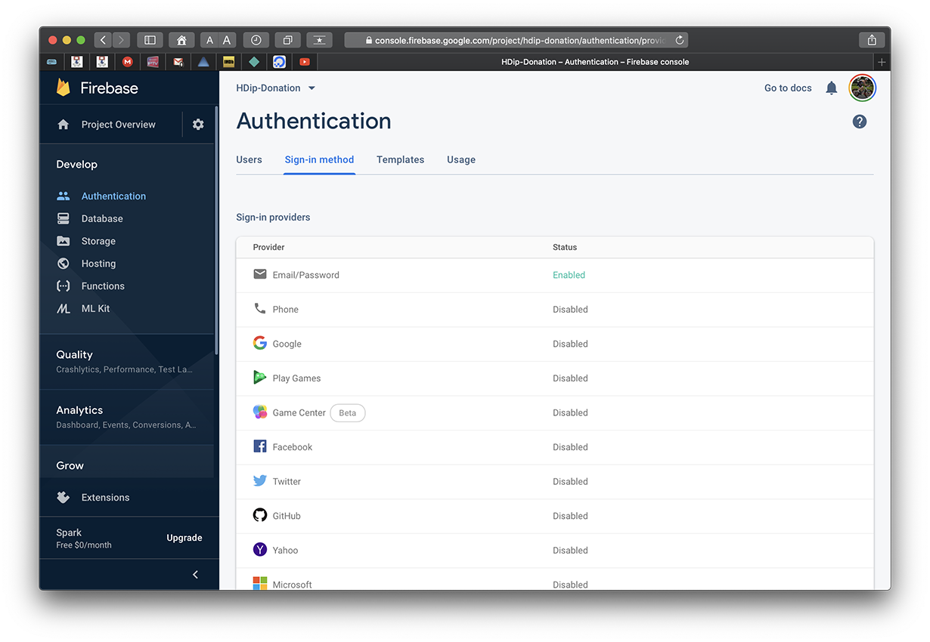
2. Setup your Sign-In Method

Slide 9
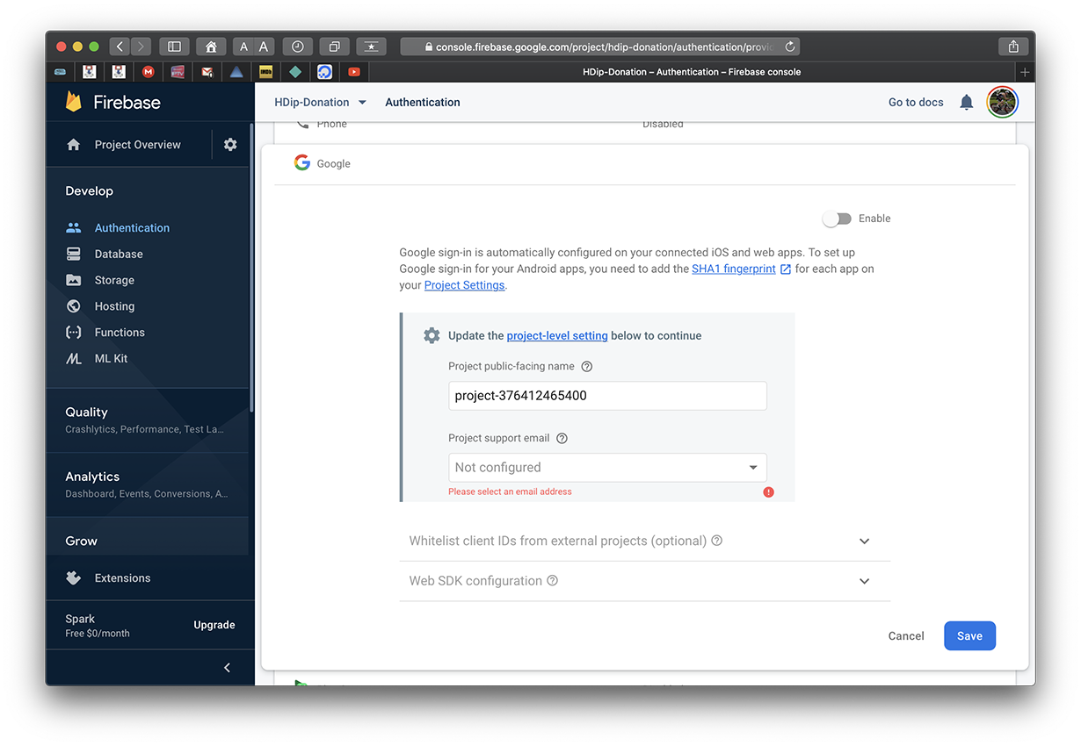
2. Setup your Sign-In Method

Slide 10
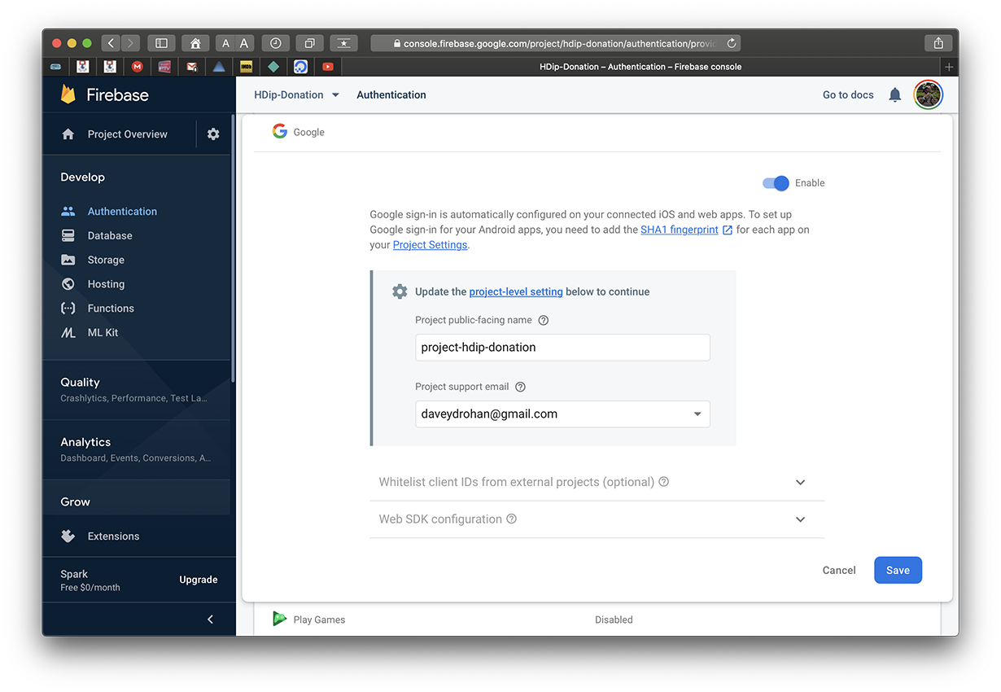
2. Setup your Sign-In Method

Slide 11

2. Setup your Sign-In Method

Slide 12
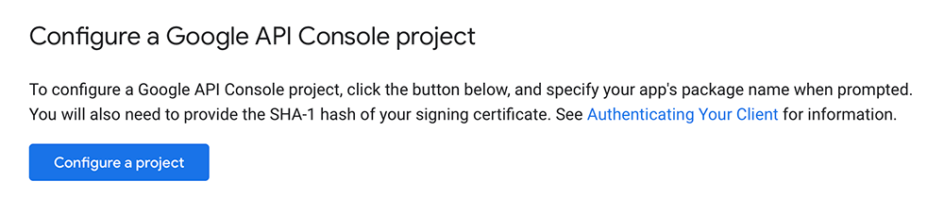
3. Setup your Sign-In Method (via Web Link)
(Detailed Instructions in the Lab)

Slide 13
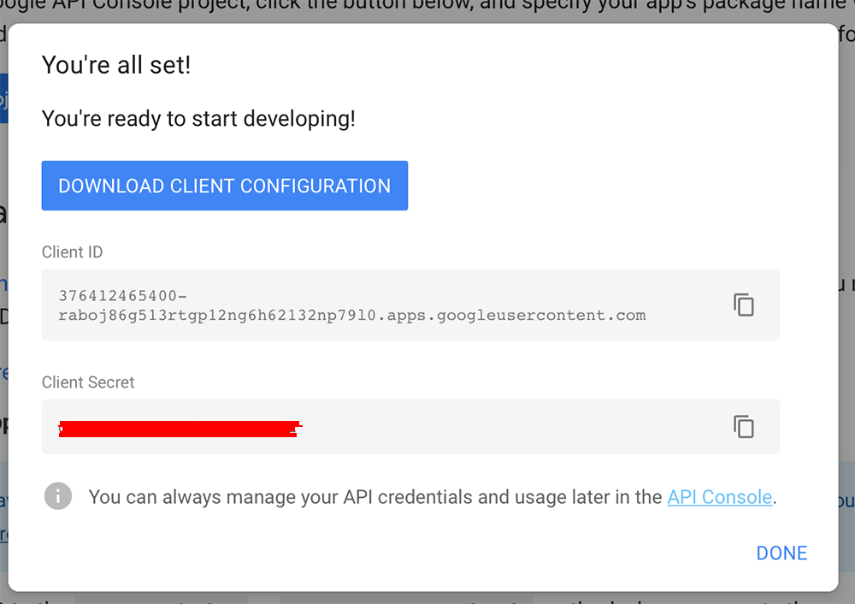
3. Setup your Sign-In Method (via Web Link)

Slide 14
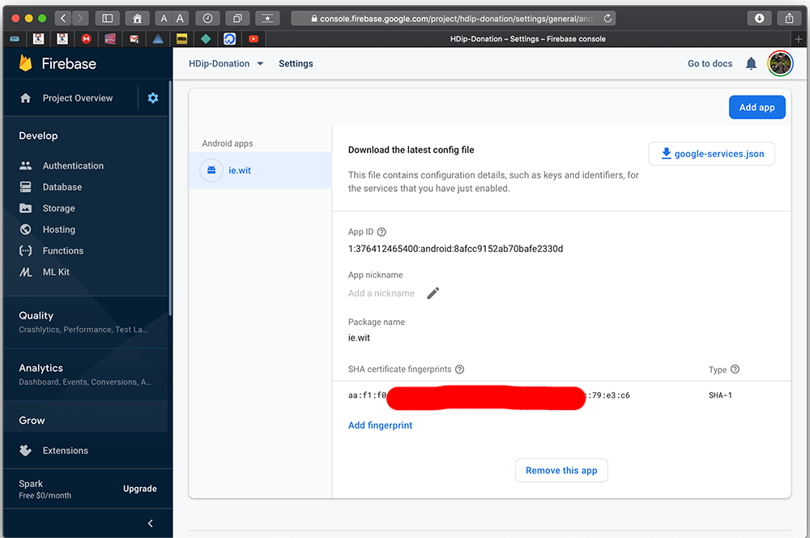
3. Setup your Sign-In Method (via Web Link)

Slide 15
4. Setup Authentication Flow & UI
https://github.com/firebase/quickstart-android

Slide 16
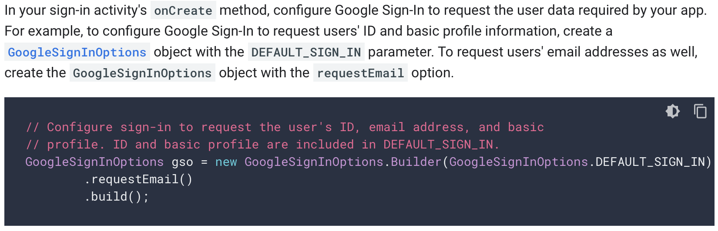
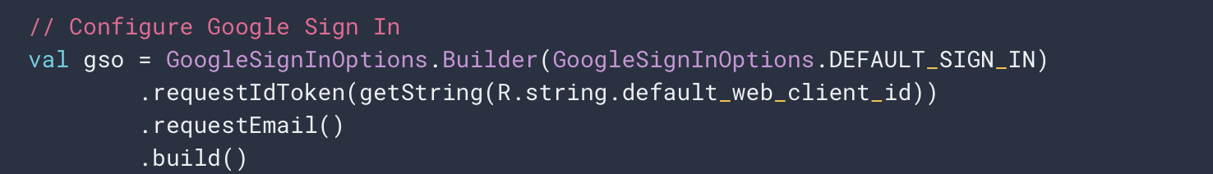
4. Configure Google Sign-in & GoogleSignInClient

Slide 17
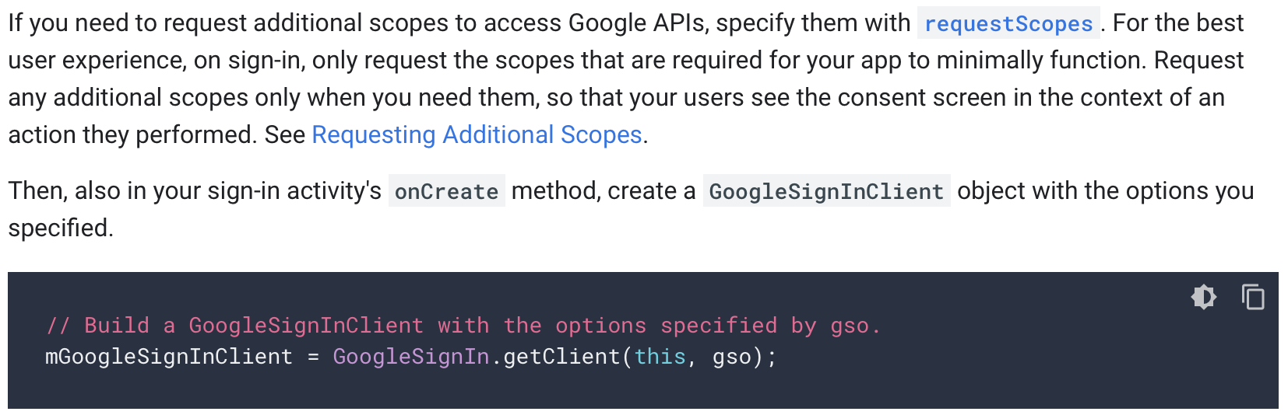
4. Configure Google Sign-in & GoogleSignInClient

Slide 18
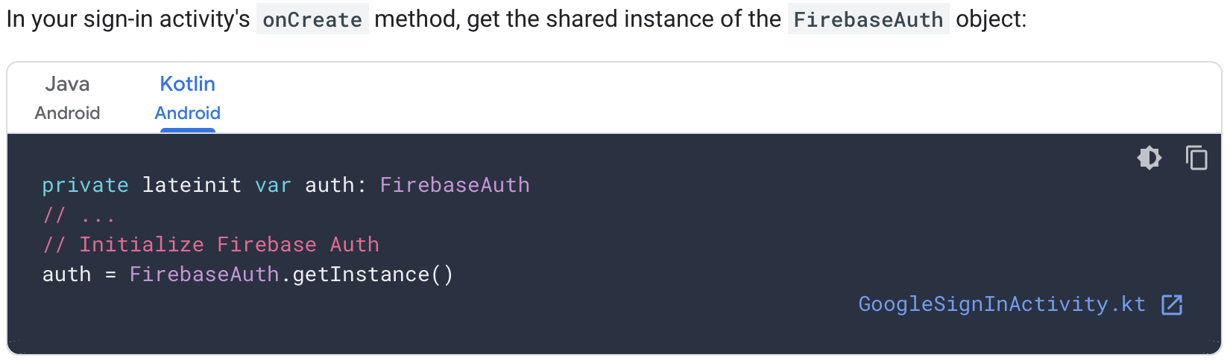
4. Get Firebase Auth Shared Instance

Slide 19
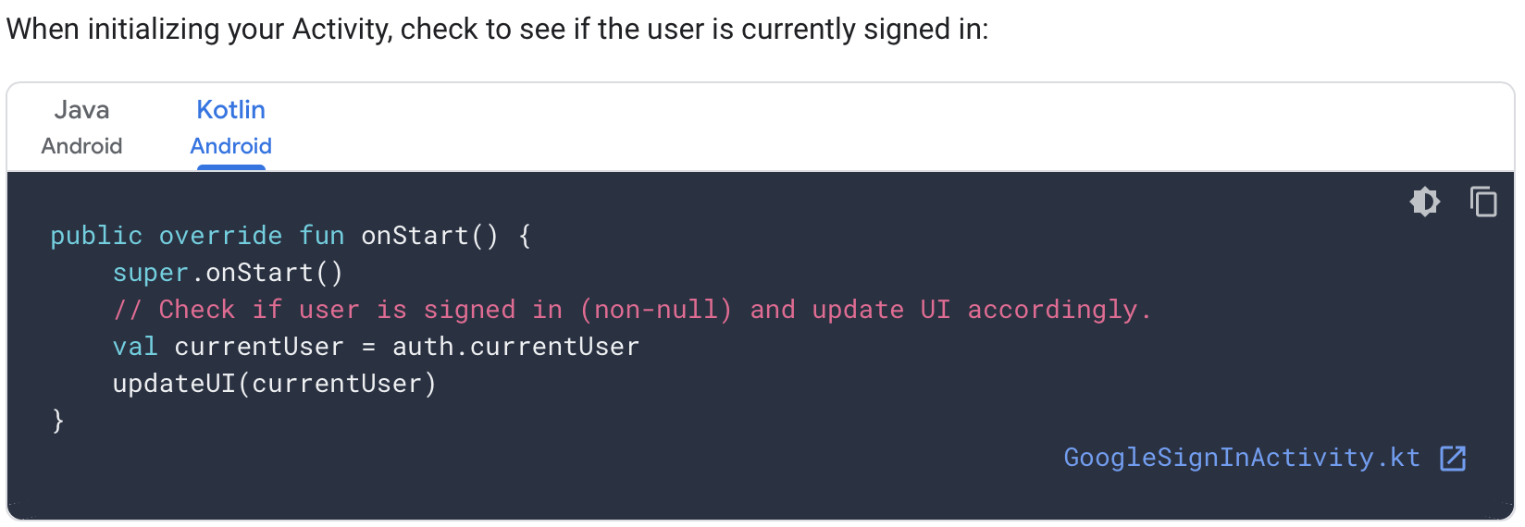
4. Check for Existing Signed In User

Slide 20
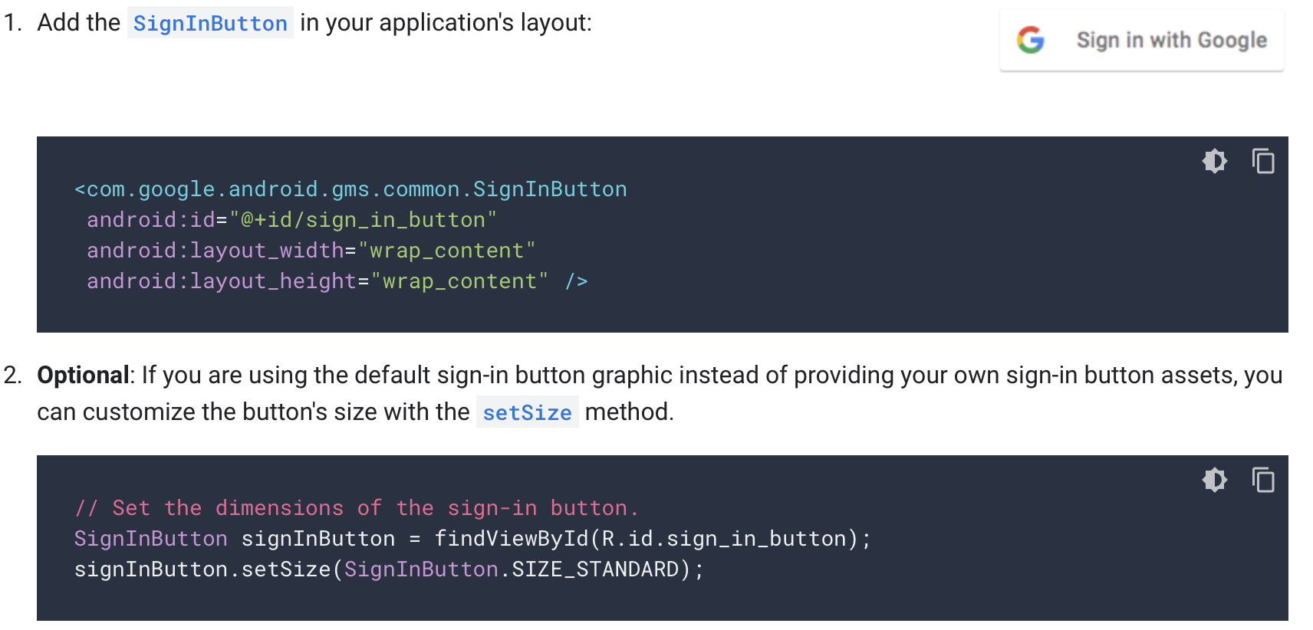
4. Add the Google Sign-in button to your app

Slide 21
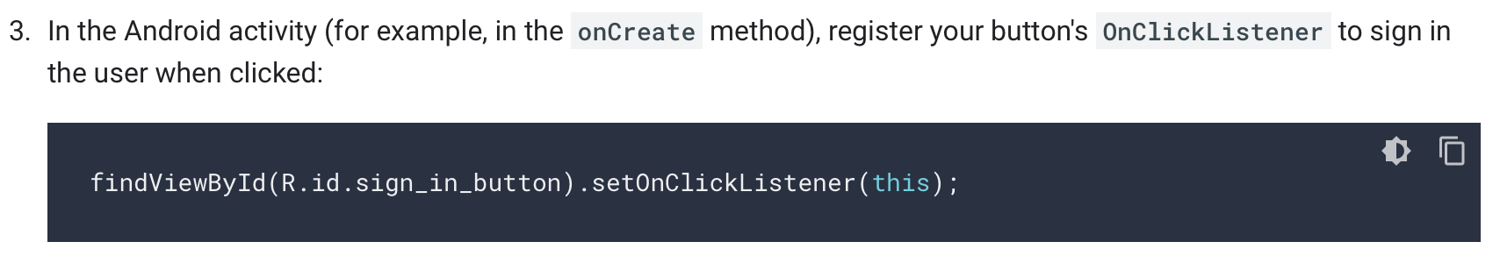
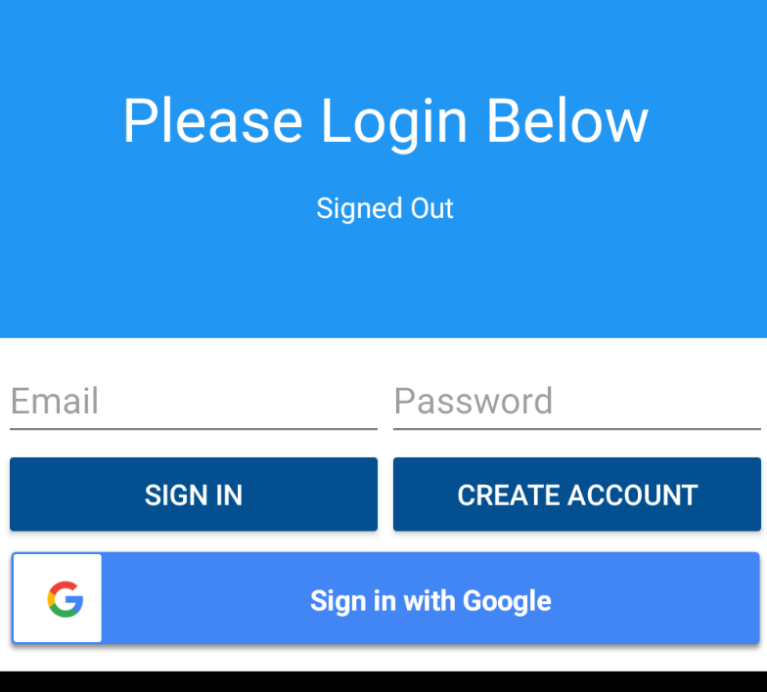
4. Add the Google Sign-in button to your app
sign_in_button.setOnClickListener(this)

Slide 22
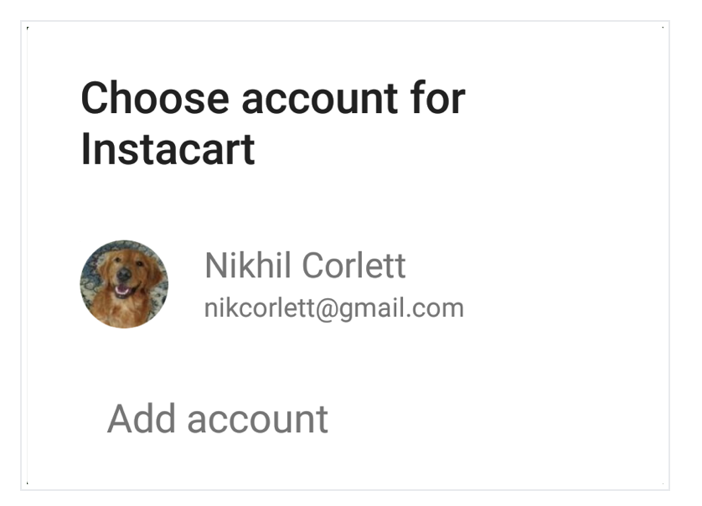
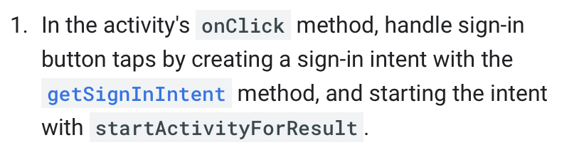
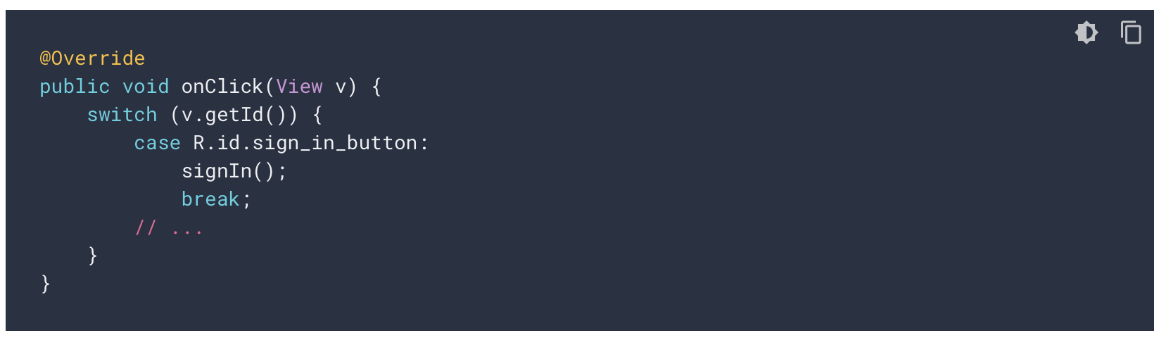
4. Start the Sign-in Flow

Slide 23
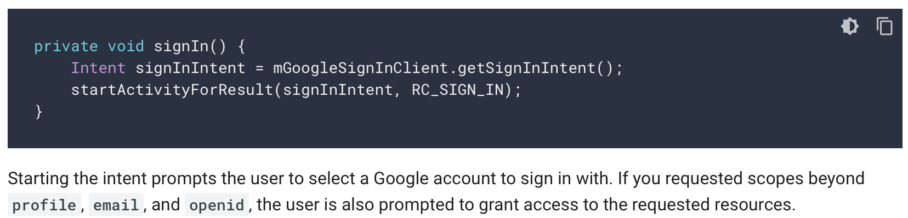
4. Start the Sign-in Flow

Slide 24
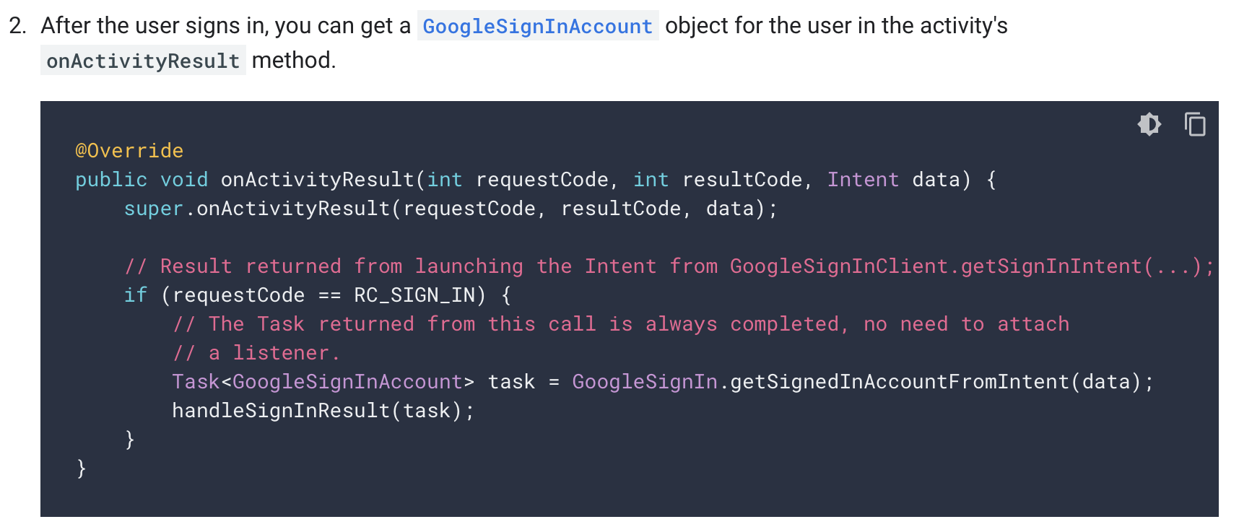
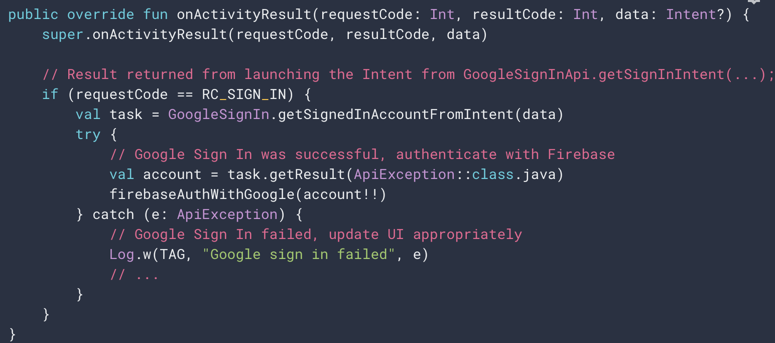
4. Start the Sign-in Flow

Slide 25
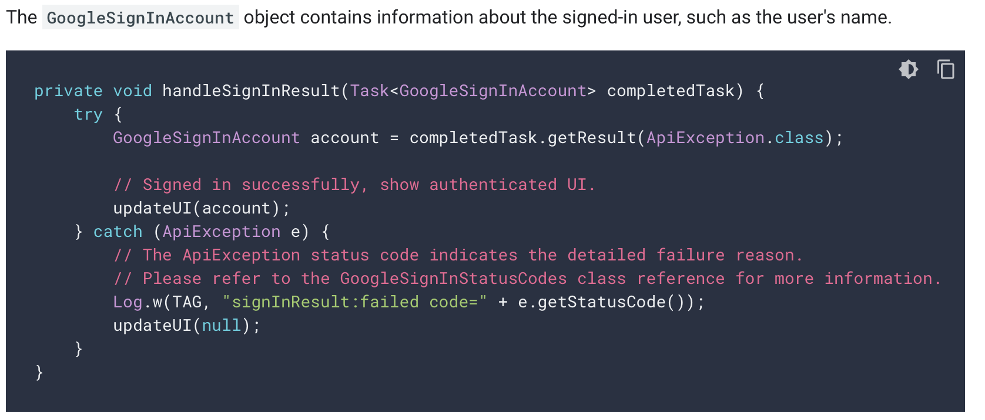
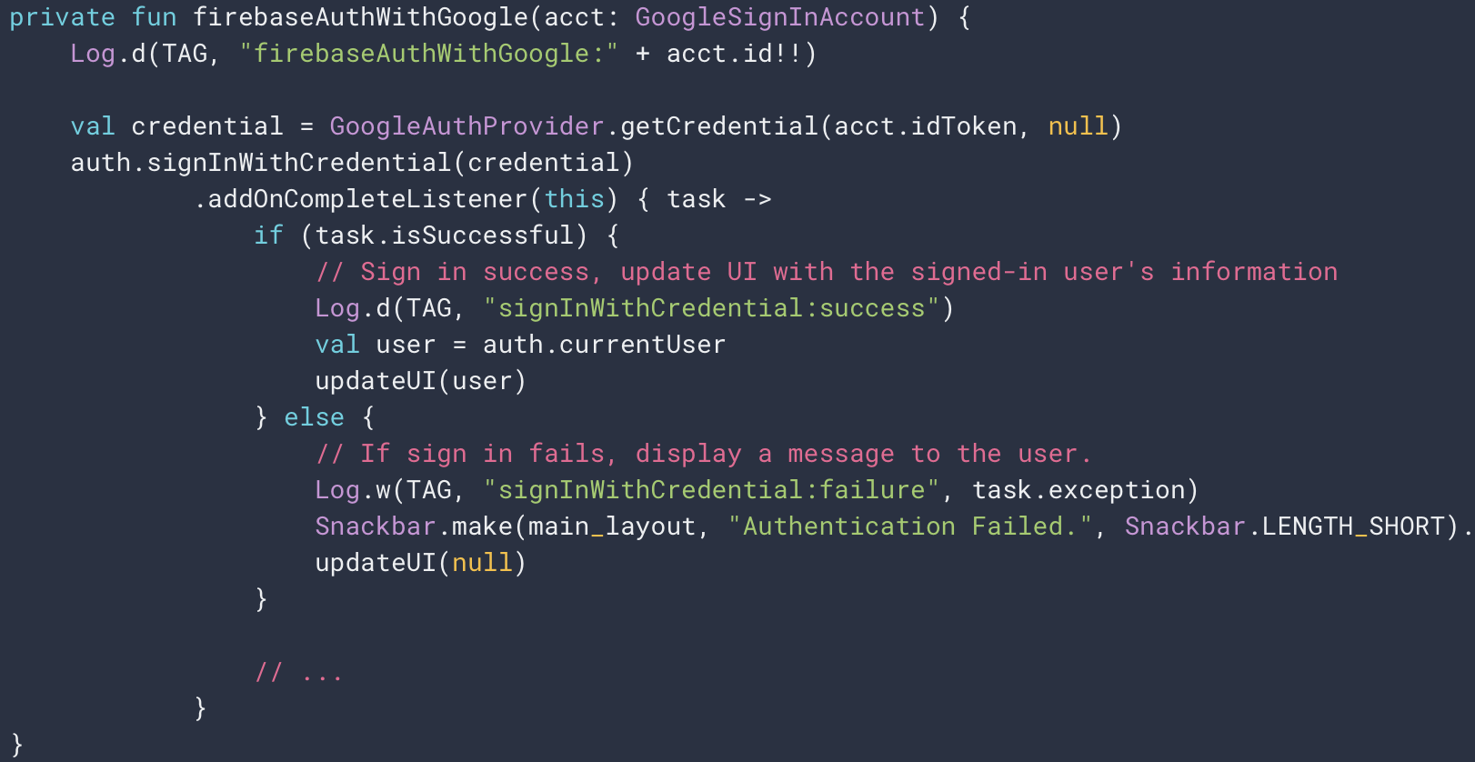
4. Start the Sign-in Flow

Slide 26
4. Start the Sign-in Flow (Extra bits)
You can also get the user's email address with getEmail(),
The user's Google ID (for client-side use) with getId(), and
An ID token for the user with getIdToken()
If you need to pass the currently signed-in user to a backend server, send the ID token to your backend server and validate the token on the server

Slide 27
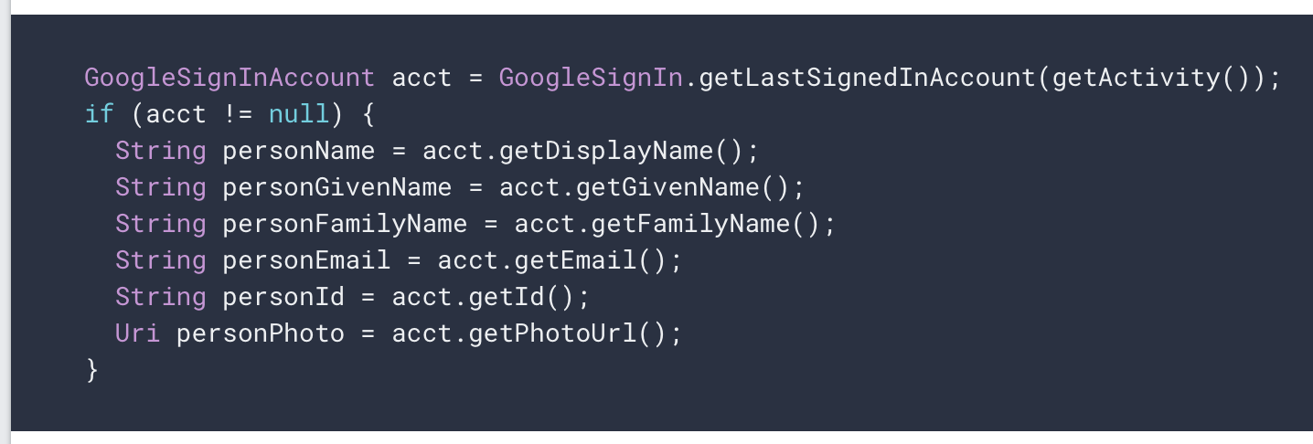
4. Start the Sign-in Flow (Extra bits)

Slide 28
We’ll look at what we do with the Google authenticated user in the Code walkthrough and the Lab

Slide 29
References
https://console.firebase.google.com/
https://firebase.google.com/
https://github.com/firebase/quickstart-android
https://firebase.google.com/docs/auth/android/google-signin
https://developers.google.com/identity

Slide 30


